Slide 1

MQTT – Message queue telemetry transport
Chapter Contents:-
What is MQTT
MQTT Architecture
MQTT Client Operations
MQTT QoS
MQTT Topics
MQTT Header and Payload
MQTT Messages
MQTT Contiki APIs

Slide 2
MQTT
Protocol runs over TCP/IP
Uses Publish Subscribe messaging pattern
Message broker distributes topics with clients
topics are UTF-8 string based, with hierarchical structure
Decouples clients
Three quality of service for data delivery

Slide 3
MQTT Contd.
Binary header and lightweight protocol
A messaging transport that is agnostic to the content of payload
Retain Flag – New subscribed clients shall receive last value
Last Will – Notify other clients when disconnected ungracefully
Keep Alive – Ping request message to broker

Slide 4
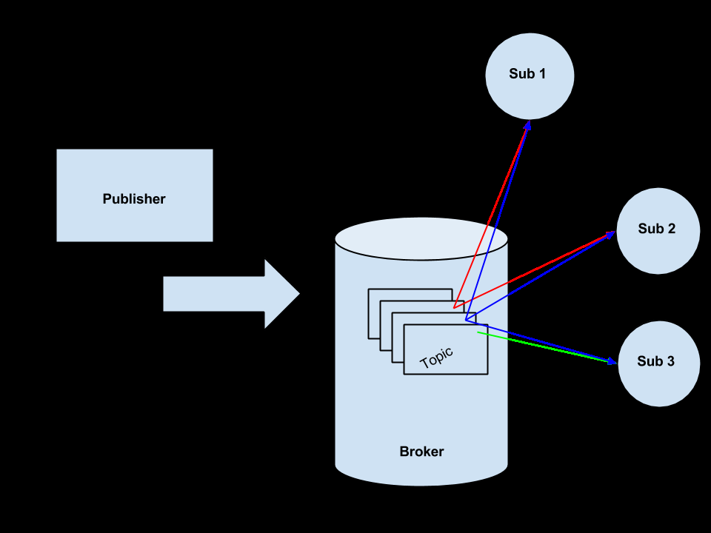
MQTT – Publish Subscribe

Slide 5
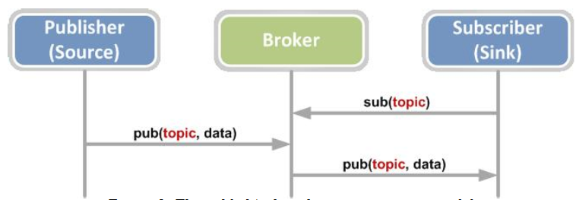
MQTT Architecture

Slide 6
MQTT Client Operations
Connect : Wait for the connection to be established with server
Disconnect : Wait for the MQTT Client to finish any pending tasks and then closes the TCP connection
Subscribe: Requests the server to subscribe the client to one or more topics
Unsubscribe : Requests the server to unsubscribe the client on one or more topics
Publish : Client updates the server with data on a topic

Slide 7
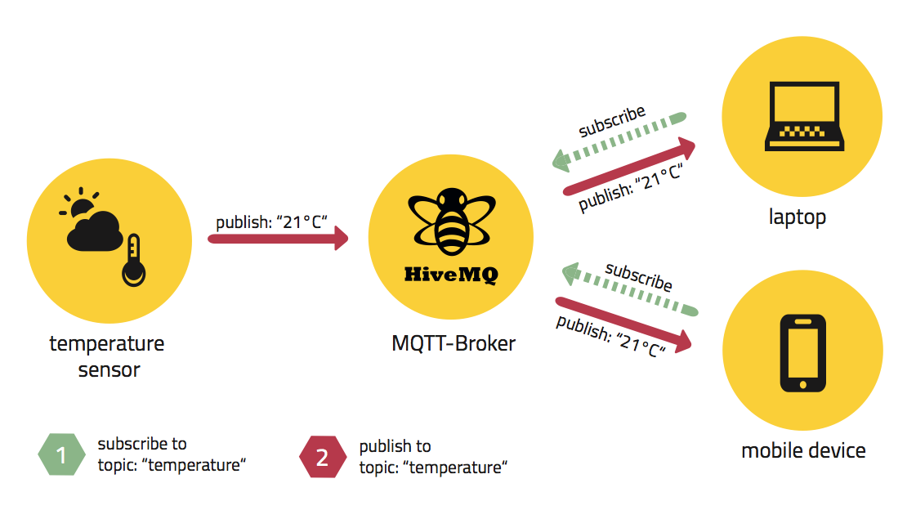
Ref : https://www.hivemq.com/blog/how-to-get-started-with-mqtt/

Slide 8
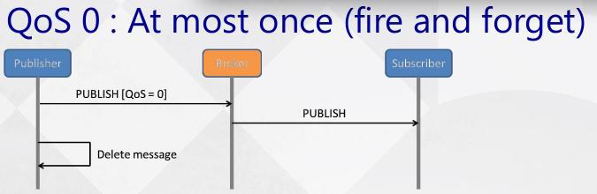
MQTT QoS 0
Ref : https://www.slideshare.net/paolopat/mqtt-iot-protocols-comparison

Slide 9
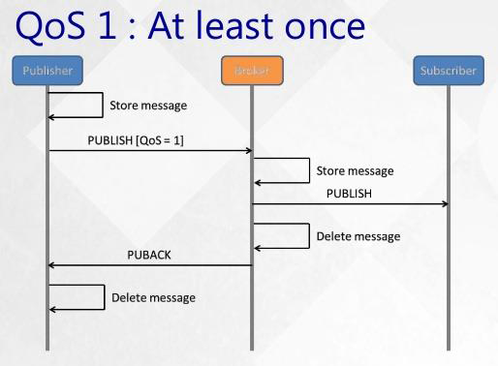
MQTT QoS 1
Ref : https://www.slideshare.net/paolopat/mqtt-iot-protocols-comparison

Slide 10
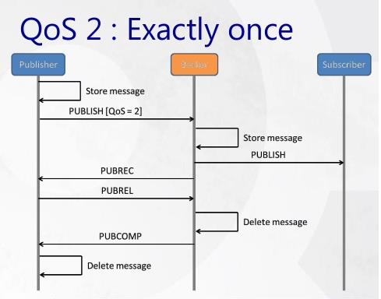
MQTT QoS 2
Ref : https://www.slideshare.net/paolopat/mqtt-iot-protocols-comparison

Slide 11
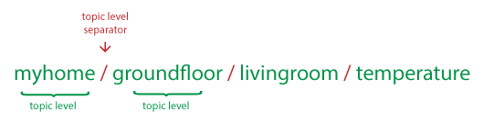


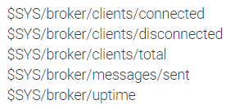
MQTT - Topics
Topics starting with $ are special
https://www.hivemq.com/blog/mqtt-essentials-part-5-mqtt-topics-best-practices/

Slide 12
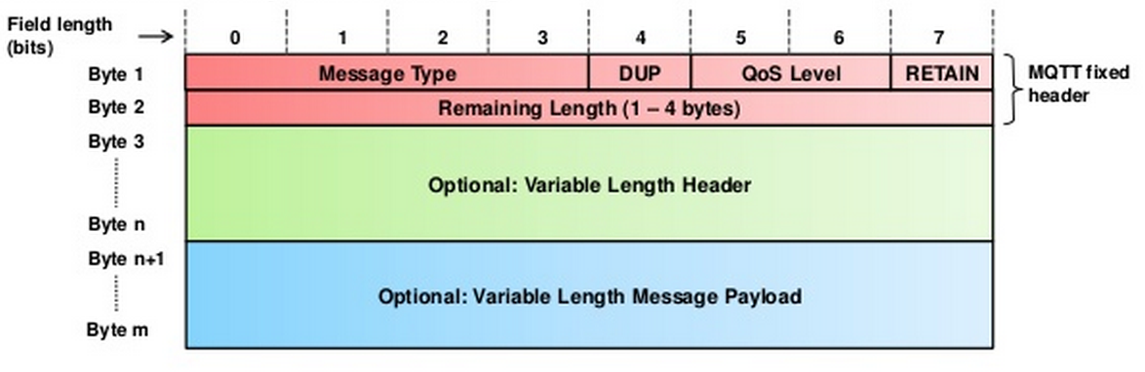
MQTT Header and Payload

Slide 13
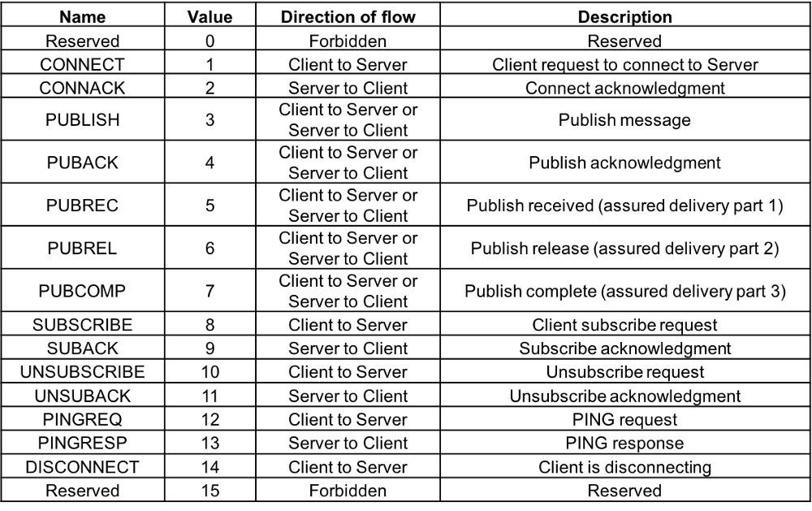
MQTT Messages

Slide 14
MQTT APIs in Contiki-OS
MQTT is implemented in contiki in apps/mqtt
Current version of Contiki supports QoS – 0 and 1
A walk through with contiki APIs for MQTT applications

Slide 15
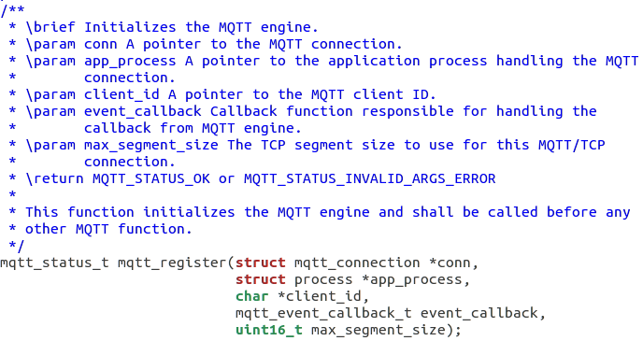
To start MQTT client this function should be called first

Slide 16
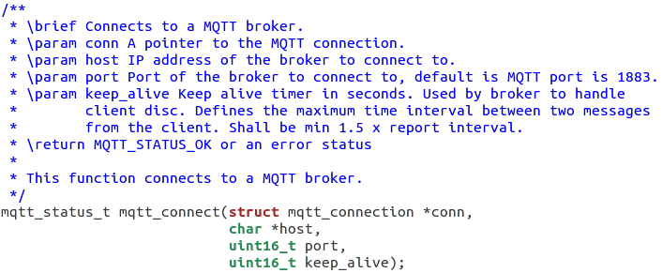
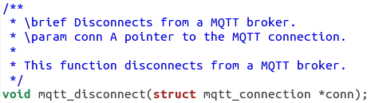
This function connects to an MQTT broker

Slide 17
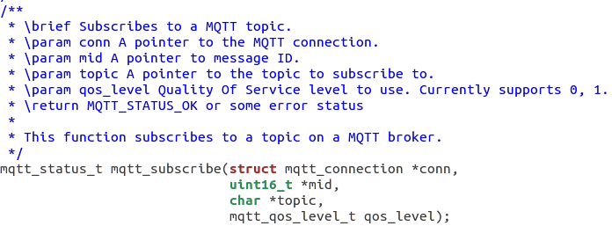
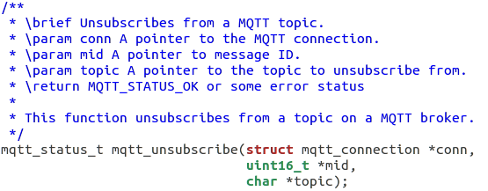
MQTT Subscription
Message ID mid = 0 for QoS 0

Slide 18
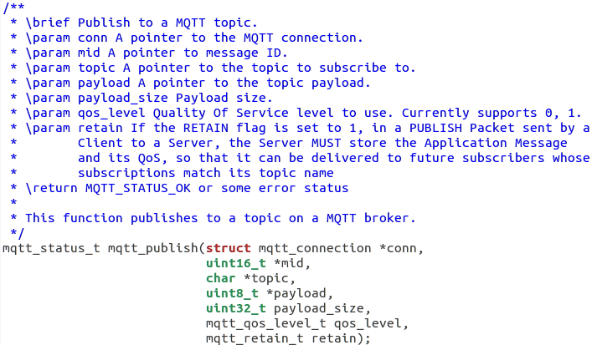
MQTT Publication

Slide 19
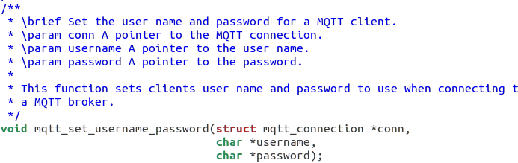
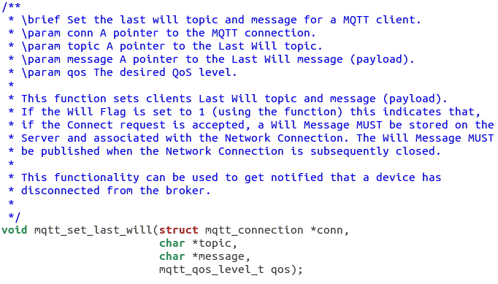
MQTT Authorizing and Last Will

Slide 20
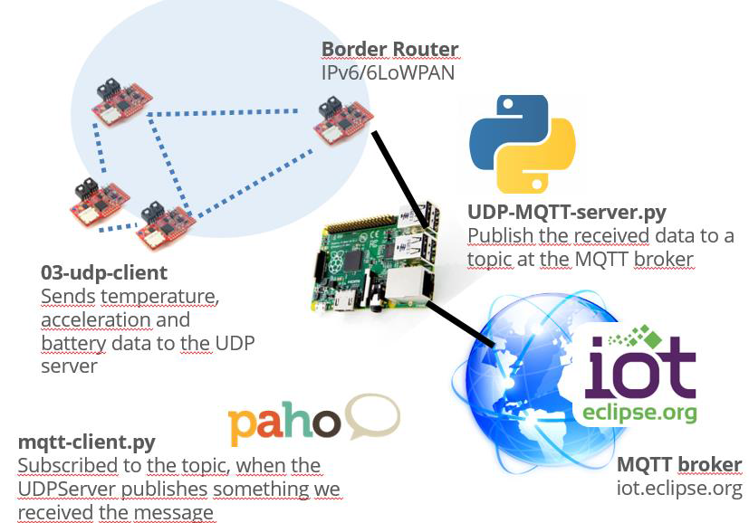

Slide 21
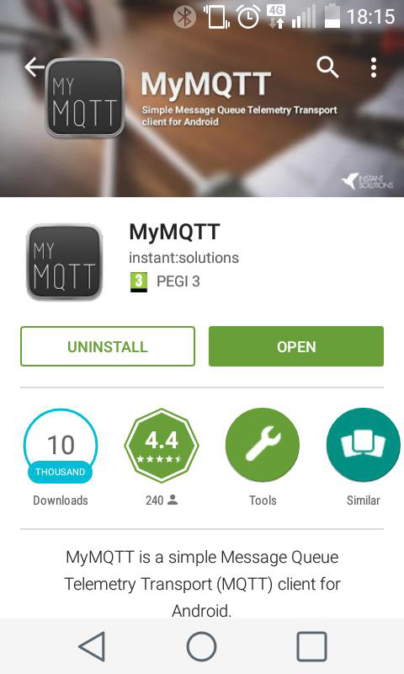

Slide 22
MCQs
MQTT based communication requires the following?
Publisher
Subscriber
Broker
All the above
MQTT supports ________ number of QoS?
1
2
3
4

Slide 23
MCQs
3. In MQTT topics are ______________ based.
String
Integer number
Floating point number
Any of the above
4. MQTT is based on ________ transport layer protocol
UDP
TCP
IPv4
IPv6

Slide 24
MCQs
5. Which of the following MQTT QoS follows fire and forget principle?
QoS 0
QoS 1
QoS 2
QoS 3
6. Which of the following MQTT QoS assures atleast once the messages arrive ?
QoS 0
QoS 1
QoS 2
QoS 3

Slide 25
MCQs
7. Which of the following MQTT QoS assures no duplicate message arrives ?
QoS 0
QoS 1
QoS 2
QoS 3
8. Which of the following is true for MQTT?
Binary header
Small code footprint
Data Agnostic
All the above

Slide 26
Answers
Question Number | Answer
1 | D
2 | C
3 | A
4 | B
5 | A
6 | B
7 | C
8 | D

